Slide 1
Quantification of Laying Hen Behaviors using Computer Vision and RFID Technology
Akash D Nakarmi
Dr. Lie Tang
Dr. Hongwei Xin

Slide 2
Presentation Outline
Motivation
Objectives
Methodology
Results
Conclusions

Slide 3
SD Effect on Laying Hen Behaviors
Motivation
spatial requirement for laying hens and its impact on their welfare remains a debatable topic
manual video analysis for tracking and registering hen behaviors is resource intensive and prone to human error
need for automatic quantification of individual laying hens in a group housed setting

Slide 4
SD Effect on Laying Hen Behaviors
Objectives
The main objective of the research is to automatically quantify certain laying hen behaviors such as locomotion, perching, nesting, feeding and drinking
Develop the system using state-of-the-art time of flight (ToF) based 3D sensor in conjunction with floor embedded radio frequency identification (RFID) sensor network
Perform lab scale experiments with different stocking densities (5 and 10 birds in 4 ft. x 4 ft. housing)

Slide 5
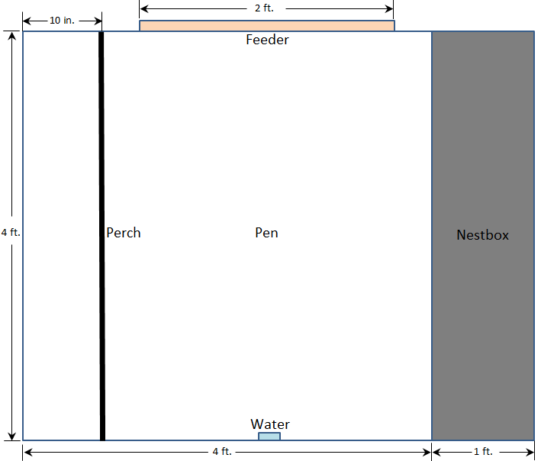
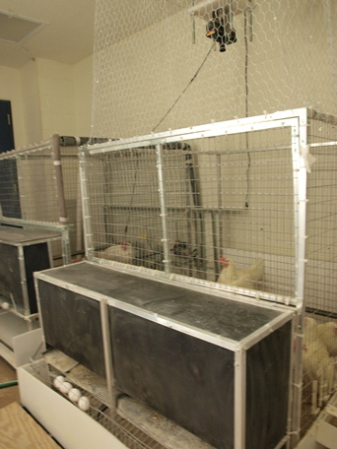
SD Effect on Laying Hen Behaviors
Experimental pen

Slide 6
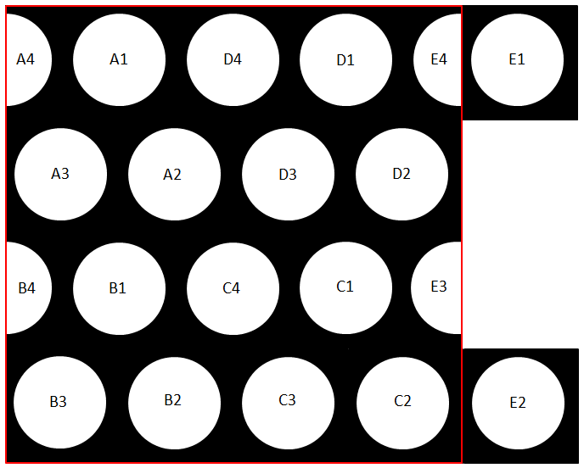
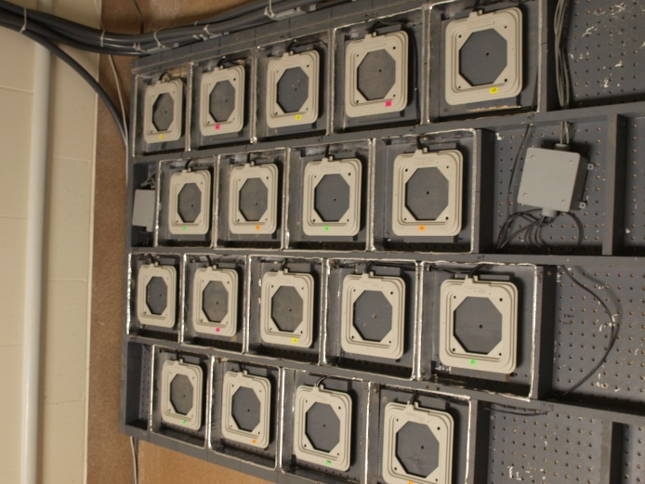
SD Effect on Laying Hen Behaviors
RFID network

Slide 7
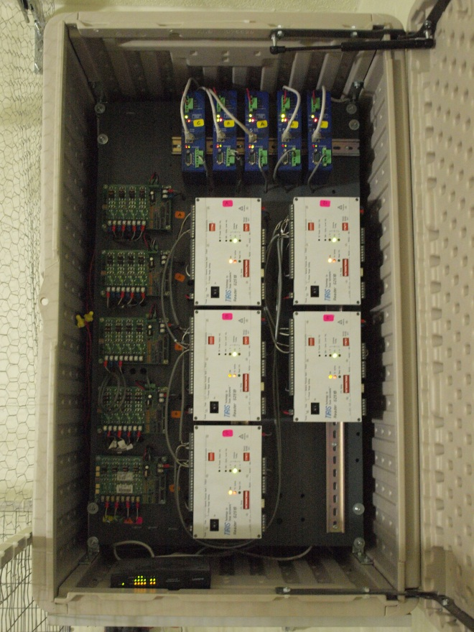
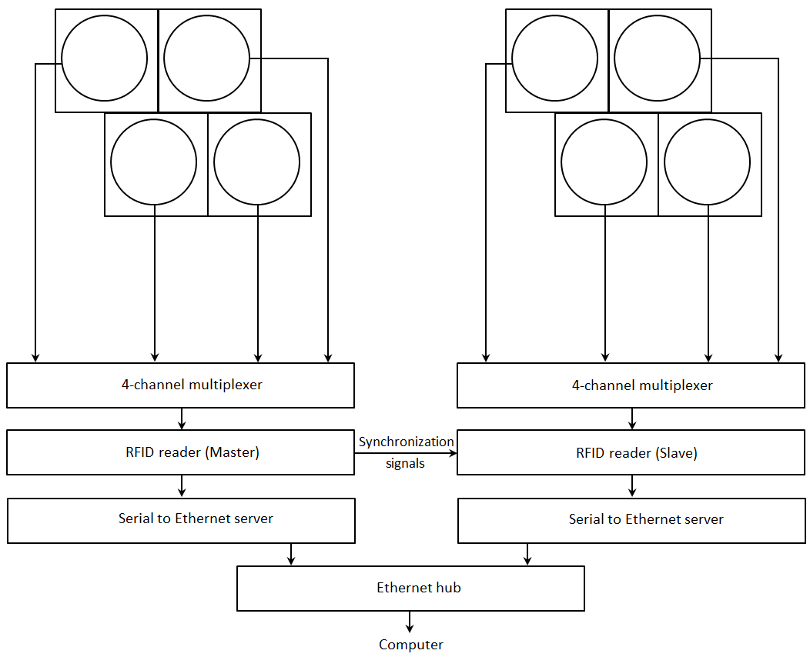
SD Effect on Laying Hen Behaviors
RFID network

Slide 8
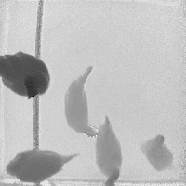
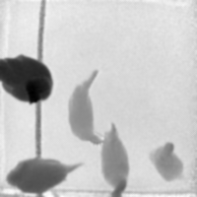
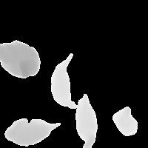
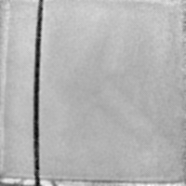
SD Effect on Laying Hen Behaviors
Foreground detection
Original image
Foreground image
Filtered image

Slide 9
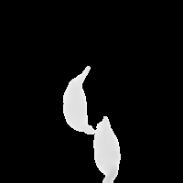
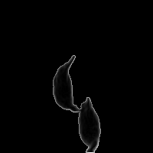


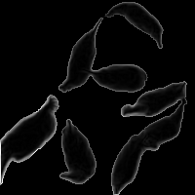
SD Effect on Laying Hen Behaviors
Gradient computation
Foreground image
Foreground selected for
gradient computation
Gradient image

Slide 10
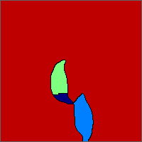

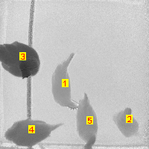
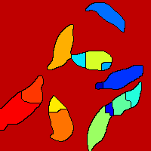

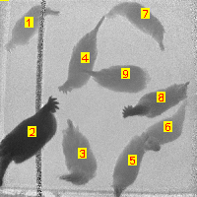
SD Effect on Laying Hen Behaviors
Hen identification
Gradient image
Watershed partitions
Detected hens
Labeled hens

Slide 11
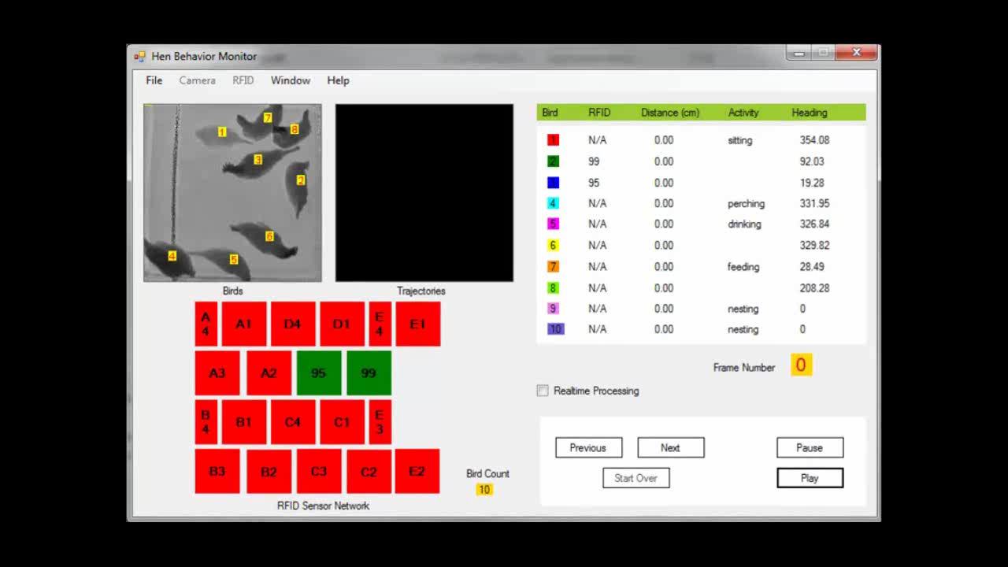
SD Effect on Laying Hen Behaviors

Slide 12
SD Effect on Laying Hen Behaviors

Slide 13
SD Effect on Laying Hen Behaviors
95% of the centroids lie within 4 pixels of the manually selected centroids
Manual selection of centroids were expected to exhibit an error of +/- 3 pixels

Slide 14
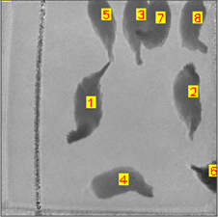
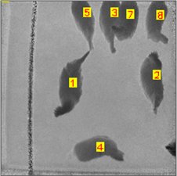
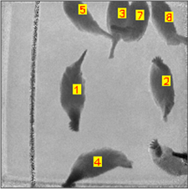
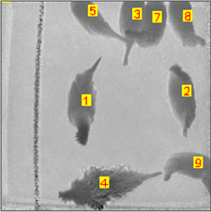
SD Effect on Laying Hen Behaviors
Hen identity recovery
Frame 401
Frame 402
Frame 475
Frame 484

Slide 15
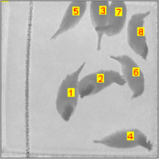
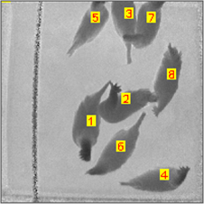
SD Effect on Laying Hen Behaviors
Hen identity recovery
Frame 651
Frame 652

Slide 16
SD Effect on Laying Hen Behaviors
Perching behavior time budget
SD5: 358±240 min-hen⁻¹-day⁻¹
SD10: 265±158 min-hen⁻¹-day⁻¹
Significant SD effect (P = 0.0023)

Slide 17
SD Effect on Laying Hen Behaviors
Nesting behavior time budget
SD5: 99±165 min-hen⁻¹-day⁻¹
SD10: 78±142 min-hen⁻¹-day⁻¹
No significant SD effect (P = 0.3597)

Slide 18
SD Effect on Laying Hen Behaviors
Feeding behavior time budget
SD5: 87±21 min-hen⁻¹-day⁻¹
SD10: 60±17 min-hen⁻¹-day⁻¹
Significant SD effect (P < 0.0001)

Slide 19
SD Effect on Laying Hen Behaviors
Drinking behavior time budget
SD5: 32±12 min-hen⁻¹-day⁻¹
SD10: 27±11 min-hen⁻¹-day⁻¹
No significant SD effect (P = 0.1366)

Slide 20
SD Effect on Laying Hen Behaviors
Time budget of movements
SD5: 499±236 m-hen⁻¹-day⁻¹
SD10: 540±160 m-hen⁻¹-day⁻¹
No significant SD effect (P = 0.2422)

Slide 21
SD Effect on Laying Hen Behaviors
Behavior | Stocking Density Effect
Perching | Yes (p=0.0023)
Nesting | No (p=0.3597)
Feeding | Yes (p<0.0001)
Drinking | No (p=0.1366)
Distance travel | No (p=0.2422)
* at 95% confidence level

Slide 22
SD Effect on Laying Hen Behaviors
Conclusions
method for automatic quantification of laying hen behaviors was developed
stocking density effect on certain laying hen behaviors such as locomotion, perching, nesting, and feeding/drinking was analyzed
for the system to run in real-time, image processing algorithms need to be optimized and/or hardware implemented

Slide 23
Thank you.
Questions / Suggestions?

